Slide 1
Data Structures & Algorithms (CSC-214)
Queues – Linked List based implementation

Slide 2
Pointer-based Implementation

Slide 3
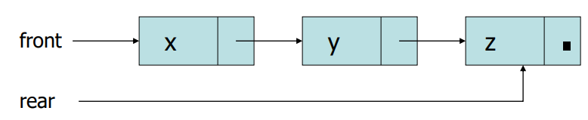
Pointer-Based Implementation of Queues
Queue Class maintains two pointers
front: A pointer to the first element of the queue
rear: A pointer to the last element of the queue

Slide 4
Queue Operations (1)
MAKENULL(Q)
ENQUEUE (x, Q)
DEQUEUE (Q)

Slide 5
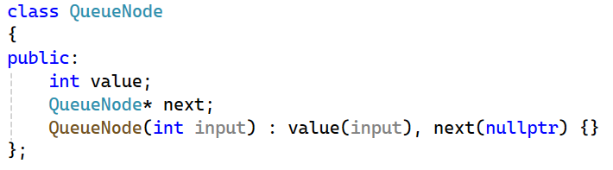
Queue Implementation (1)

Slide 6
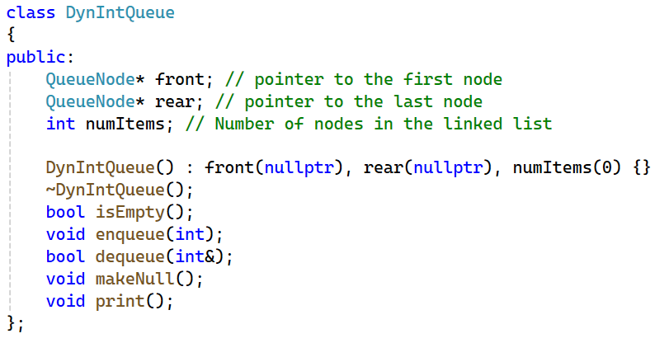
Queue Implementation (2)

Slide 7
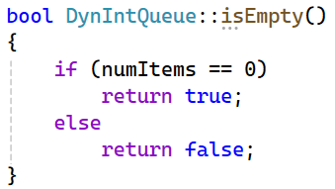
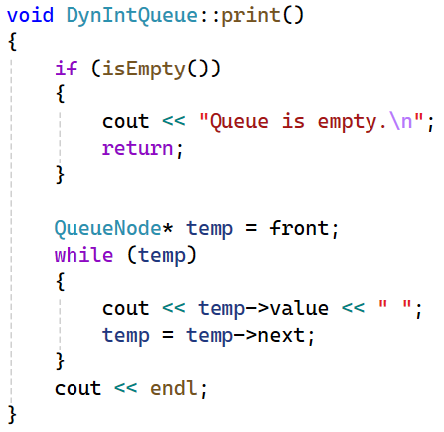
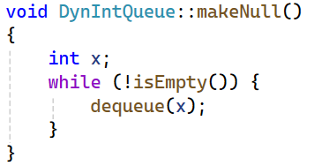
Queue Implementation (3)

Slide 8
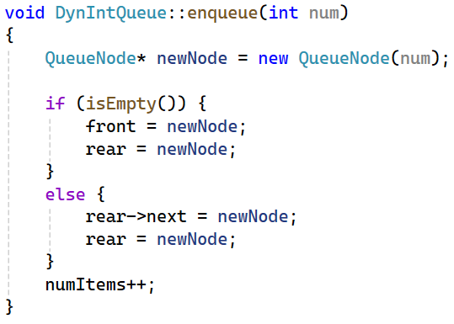
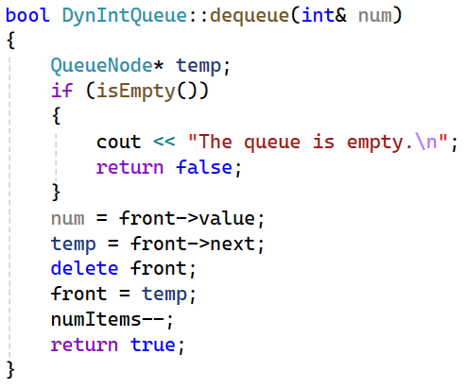
Queue Implementation (4)

Slide 9
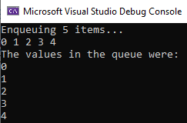
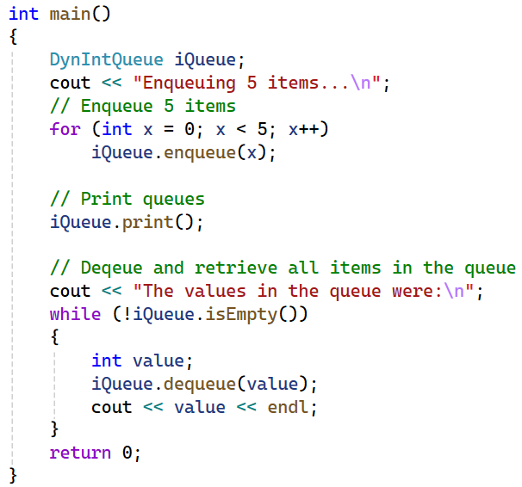
Queue Implementation (4)

Slide 10
Linked List Variations
Queues can be implemented using singly, doubly and circularly linked lists.
You should be able to handle its implementation in all such cases.

Slide 11
Practice Questions
Create a copy constructor
Overload == (is equal to) and = (assignment operator)
End of chapter, book questions from Tony Gadis, Goodrich, DS Malik.

Slide 12
Deques

Slide 13
Deque (Double Ended Queue)
Queue-like data structure that supports insertion and deletion at both the front and the rear of the queue

Slide 14
Deque (ADT)
insertFront(e)
Insert a new element e at the beginning of the deque.
insertBack(e)
Insert a new element e at the end of the deque.
eraseFront()
Remove the first element of the deque; an error occurs if the deque is empty.
eraseBack()
Remove the last element of the deque; an error occurs if the deque is empty.
front()
Return the first element of the deque; an error occurs if the deque is empty.
back()
Return the last element of the deque; an error occurs if the deque is empty.
size()
Return the number of elements of the deque.
empty()
Return true if the deque is empty and false otherwise.

Slide 15
Deque (STL)
#include <deque>
using std::deque; // make deque accessible
deque<string> myDeque; // a deque of strings
As with STL stacks and queues, an STL deque dynamically resizes itself as new elements are added.
Similar to STL stacks and queues, the result of applying any of the operations front, back, push front, or push back to an empty STL queue is undefined. Thus, no exception is thrown, but the program may abort.

Slide 16

Implementation
Deques are implemented Doubly linked list

Slide 17
Any Questions?

